Slide 1
Routing Algorithms

Slide 2
Models Of Wireless Sensor Networks
Sensor nodes used in wireless sensor networks can be fixed or mobile. So, according to this WSNs can be classified in two types:
Static Wireless Sensor Networks
Mobile Wireless Sensor Networks
a) Static Wireless Sensor Network Static wireless sensor network, have all nodes fixed at one place, i.e. there is no motion among the nodes placed in the sensor networks. This type of network model is reliable, easy to implement. To communicate between two nodes is simple as all the nodes are static.
b) Mobile Wireless Sensor Network In mobile wireless sensor networks (MWSNs), nodes are mobile, i.e. nodes can move from place to place. Due to which communication between two nodes can be very complicated. Routes selected for communication also have to change with respect to movement of nodes.
Node which has to transfer the data, called source node, and node to which the data has to be sent is called sink node.

Slide 3
The routing protocol is a process to select suitable path for the data to travel from source to destination. The process encounters several difficulties while selecting the route, which depends upon, type of network, channel characteristics and the performance metrics.
The data sensed by the sensor nodes in a wireless sensor network (WSN) is typically forwarded to the base station that connects the sensor network with the other networks (may be internet) where the data is collected, analyzed and some action is taken accordingly.

Slide 4
In very small sensor networks where the base station and motes (sensor nodes) are close to each other, they can communicate directly with each other, this is single-hop communication.
In most WSN application the coverage area is so large that requires thousands of nodes to be placed and this scenario requires multi-hop communication because most of the sensor nodes are so far from the sink node (gateway) so that they cannot communicate directly with the base station.
The single-hop communication is also called direct communication and multi-hop communication is called indirect communication.

Slide 5
In multi-hop communication the sensor nodes not only produce and deliver their material but also serve as a path for other sensor nodes towards the base station. The process of finding suitable path from source node to destination node is called routing and this is the primary responsibility of the network layer.

Slide 6
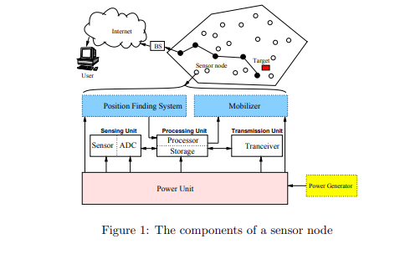

Slide 7
Routing challenges in WSNs
The design task of routing protocols for WSN is quite challenging because of multiple characteristics, which differentiate them, from wireless infrastructure-less networks. Some of important challenges are mentioned below:
It is almost difficult to allocate a universal identifiers scheme for a big quantity of sensor nodes. So, wireless sensor motes are not proficient of using classical IP-based protocols.
The flow of detected data is compulsory from a number of sources to a specific base station. But this is not occurred in typical communication networks.
The created data traffic has significant redundancy in most of cases. Because many sensing nodes can generate same data while sensing. So, it is essential to exploit such redundancy by the routing protocols and utilize the available bandwidth and energy as efficiently as possible.
Moreover wireless motes are firmly restricted in relations of transmission energy, bandwidth, capacity and storage and on-board energy. Due to such dissimilarities, a number of new routing protocols have been projected in order to cope up with these routing challenges in wireless sensor networks.

Slide 8
Routing Challenges and Design Issues in WSNs
There are some major design challenges in wireless sensor networks due to lack of resources such as energy, bandwidth and storage of processing. While designing new routing protocols, the following essentials should be fulfilled by a network engineer.
Complexity
The complexity of a routing protocol may affect the performance of the entire wireless network. The reason behind is that we have inadequate hardware competences and we also face extreme energy limitations in wireless sensor networks.

Slide 9
Sensor location
Another major challenge that is faced by wireless sensor network designers is to correctly locate the sensor nodes. Most routing protocols use some localization technique to obtain knowledge concerning their locations. Global positioning system (GPS) receivers are used in some scenario.

Slide 10
Node deployment:
Node deployment in WSNs is application dependent and affects the performance of the routing protocol. The deployment can be either deterministic or randomized. In deterministic deployment, the sensors are manually placed and data is routed through pre-determined paths. However, in random node deployment, the sensor nodes are scattered randomly creating an infrastructure in an ad hoc manner. If the resultant distribution of nodes is not uniform, optimal clustering becomes necessary to allow connectivity and enable energy efficient network operation. Inter-sensor communication is normally within short transmission ranges due to energy and bandwidth limitations. Therefore, it is most likely that a route will consist of multiple wireless hops.

Slide 11
Energy consumption without losing accuracy: sensor nodes can use up their limited supply of energy performing computations and transmitting information in a wireless environment. As such, energy conserving forms of communication and computation are essential. Sensor node lifetime shows a strong dependence on the battery lifetime. In a multihop WSN, each node plays a dual role as data sender and data router. The malfunctioning of some sensor nodes due to power failure can cause significant topological changes and might require rerouting of packets and reorganization of the network.

Slide 12
Data Reporting Model: Data sensing and reporting in WSNs is dependent on the application and the time criticality of the data reporting. Data reporting can be categorized as either time-driven (continuous), event-driven, query-driven, and hybrid . The time-driven delivery model is suitable for applications that require periodic data monitoring. As such, sensor nodes will periodically switch on their sensors and transmitters, sense the environment and transmit the data of interest at constant periodic time intervals. In event-driven and query-driven models, sensor nodes react immediately to sudden and drastic changes in the value of a sensed attribute due to the occurrence of a certain event or a query is generated by the BS. As such, these are well suited for time critical applications. A combination of the previous models is also possible. The routing protocol is highly influenced by the data reporting model with regard to energy consumption and route stability.

Slide 13
Node/Link Heterogeneity: In many studies, all sensor nodes were assumed to be homogeneous, i.e., having equal capacity in terms of computation, communication, and power. However, depending on the application a sensor node can have different role or capability. The existence of heterogeneous set of sensors raises many technical issues related to data routing. For example, some applications might require a diverse mixture of sensors for monitoring temperature, pressure and humidity of the surrounding environment, detecting motion via acoustic signatures, and capturing the image or video tracking of moving objects. These special sensors can be either deployed independently or the different functionalities can be included in the same sensor nodes. Even data reading and reporting can be generated from these sensors at different rates, subject to diverse quality of service constraints, and can follow multiple data reporting models. For example, hierarchical protocols designate a clusterhead node different from the normal sensors. These clusterheads can be chosen from the deployed sensors or can be more powerful than other sensor nodes in terms of energy, bandwidth, and memory. Hence, the burden of transmission to the BS is handled by the set of cluster-heads.

Slide 14
Fault Tolerance:
Wireless sensor networks are deployed in very crucial and loss environments frequently. Occasionally, a sensor node might be expire or leaving the wireless sensor network. Thus, the routing protocol should be capable to accept all sorts of environments including severe and loss environments. The functionality of the routing protocol should be fine also
Some sensor nodes may fail or be blocked due to lack of power, physical damage, or environmental interference. The failure of sensor nodes should not affect the overall task of the sensor network. If many nodes fail, MAC and routing protocols must accommodate formation of new links and routes to the data collection base stations. This may require actively adjusting transmit powers and signaling rates on the existing links to reduce energy consumption, or rerouting packets through regions of the network where more energy is available. Therefore, multiple levels of redundancy may be needed in a fault-tolerant sensor network.

Slide 15
Scalability: The number of sensor nodes deployed in the sensing area may be in the order of hundreds or thousands, or more. Any routing scheme must be able to work with this huge number of sensor nodes. In addition, sensor network routing protocols should be scalable enough to respond to events in the environment. Until an event occurs, most of the sensors can remain in the sleep state, with data from the few remaining sensors providing a coarse quality.

Slide 16
Network Dynamics: Most of the network architectures assume that sensor nodes are stationary. However, mobility of both BS’s or sensor nodes is sometimes necessary in many applications. Routing messages from or to moving nodes is more challenging since route stability becomes an important issue, in addition to energy, bandwidth etc. Moreover, the sensed phenomenon can be either dynamic or static depending on the application, e.g., it is dynamic in a target detection/tracking application, while it is static in forest monitoring for early fire prevention. Monitoring static events allows the network to work in a reactive mode, simply generating traffic when reporting. Dynamic events in most applications require periodic reporting and consequently generate significant traffic to be routed to the BS.

Slide 17
Connectivity: High node density in sensor networks precludes them from being completely isolated from each other. Therefore, sensor nodes are expected to be highly connected. This, however, may not prevent the network topology from being variable and the network size from being shrinking due to sensor node failures. In addition, connectivity depends on the, possibly random, distribution of nodes.

Slide 18
Coverage: In WSNs, each sensor node obtains a certain view of the environment. A given sensor’s view of the environment is limited both in range and in accuracy; it can only cover a limited physical area of the environment. Hence, area coverage is also an important design parameter in WSNs.
• Data Aggregation: Since sensor nodes may generate significant redundant data, similar packets from multiple nodes can be aggregated so that the number of transmissions is reduced. Data aggregation is the combination of data from different sources according to a certain aggregation function, e.g., duplicate suppression, minima, maxima and average. This technique has been used to achieve energy efficiency and data transfer optimization in a number of routing protocols. Signal processing methods can also be used for data aggregation. In this case, it is referred to as data fusion where a node is capable of producing a more accurate output signal by using some techniques such as beamforming to combine the incoming signals and reducing the noise in these signals.

Slide 19
Quality of Service: In some applications, data should be delivered within a certain period of time from the moment it is sensed, otherwise the data will be useless. Therefore bounded latency for data delivery is another condition for time-constrained applications. However, in many applications, conservation of energy, which is directly related to network lifetime, is considered relatively more important than the quality of data sent. As the energy gets depleted, the network may be required to reduce the quality of the results in order to reduce the energy dissipation in the nodes and hence lengthen the total network lifetime. Hence, energy-aware routing protocols are required to capture this requirement.

Slide 20
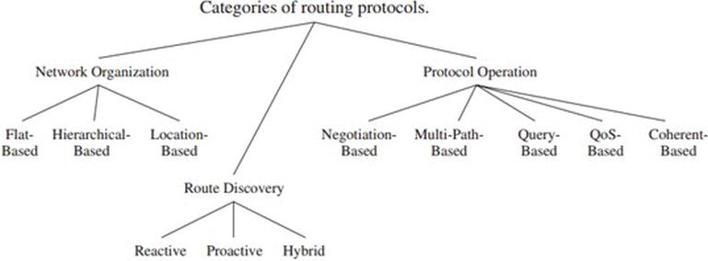

Slide 21
Characteristics of WSN
In WSNs, sometimes getting the data is more important than knowing the IDs of which nodes sent the data.
Second, in contrast to typical communication networks, almost all applications of sensor networks require the flow of sensed data from multiple sources to a particular BS. This, however, does not prevent the flow of data to be in other forms (e.g., multicast or peer to peer).
Third, sensor nodes are tightly constrained in terms of energy, processing, and storage capacities. Thus, they require careful resource management.
Fourth, in most application scenarios, nodes in WSNs are generally stationary after deployment except for, may be, a few mobile nodes. Nodes in other traditional wireless networks are free to move, which results in unpredictable and frequent topological changes. However, in some applications, some sensor nodes may be allowed to move and change their location (although with very low mobility).
Fifth, sensor networks are application specific, i.e., design requirements of a sensor network change with application. For example, the challenging problem of low-latency precision tactical surveillance is different from that required for a periodic weather-monitoring task

Slide 22
sixth, position awareness of sensor nodes is important since data collection is normally based on the location. Currently, it is not feasible to use Global Positioning System (GPS) hardware for this purpose. Methods based on triangulation , for example, allow sensor nodes to approximate their position using radio strength from a few known points. It is found in that algorithms based on triangulation or multilateration can work quite well under conditions where only very few nodes know their positions apriori, e.g., using GPS hardware. Still, it is favorable to have GPS-free solutions for the location problem in WSNs.
Finally, data collected by many sensors in WSNs is typically based on common phenomena, hence there is a high probability that this data has some redundancy. Such redundancy needs to be exploited by the routing protocols to improve energy and bandwidth utilization.
Usually, WSNs are data-centric networks in the sense that data is requested based on certain attributes, i.e., attribute-based addressing. An attribute-based address is composed of a set of attribute-value pair query. For example, if the query is something like [temperature > 60F], then sensor nodes that sense temperature > 60F only need to respond and report their readings.

Slide 23
Classification of Routing protocol
Almost all of the routing protocols can be classified according to the network structure as flat, hierarchical, or location-based.
Furthermore, these protocols can be classified into multipath-based, query-based, negotiation-based, QoS-based, and coherent-based depending on the protocol operation.
In flat networks, all nodes play the same role while hierarchical protocols aim at clustering the nodes so that cluster heads can do some aggregation and reduction of data in order to save energy.
Location-based protocols utilize the position information to relay the data to the desired regions rather than the whole network.
The last category includes routing approaches that are based on the protocol operation, which vary according to the approach used in the protocol.

Slide 24
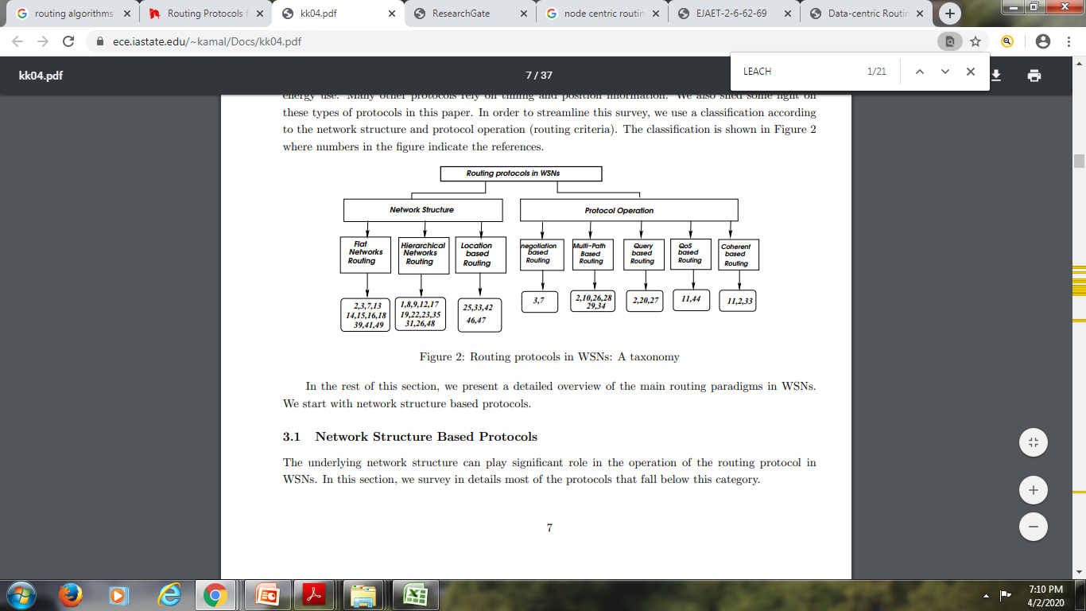

Slide 25
Network Structure Based Protocols
The underlying network structure can play significant role in the operation of the routing protocol in WSNs.

Slide 26
Flat Routing
The first category of routing protocols are the multihop flat routing protocols. In flat networks, each node typically plays the same role and sensor nodes collaborate together to perform the sensing task.
Due to the large number of such nodes, it is not feasible to assign a global identifier to each node.
This consideration has led to data centric routing, where the BS sends queries to certain regions and waits for data from the sensors located in the selected regions.
Since data is being requested through queries, attribute-based naming is necessary to specify the properties of data.
Early works on data centric routing, e.g., SPIN and directed diffusion were shown to save energy through data negotiation and elimination of redundant data.
These two protocols motivated the design of many other protocols which follow a similar concept.

Slide 27
Flooding
In this we start with a source node sending its data to all of its neighbors. Upon receiving a piece of data, each node then stores and sends a copy of the data to all of its neighbors.
This is therefore a straightforward protocol requiring no protocol state at any node, and it disseminates data quickly in a network where bandwidth is not scarce and links are not loss-prone.
It has three deficiencies which render in as an inadequate protocol.

Slide 28
These are:
a) Implosion: In classic flooding, a node always sends data to its neighbors, regardless of whether or not the neighbor has already received the data from another source. This leads to the implosion problem, illustrated in Figure 2. Here, node A starts out by flooding data to its two neighbors, B and C. These nodes store the data from A and send a copy of it on to their neighbor D. The protocol thus wastes resources by sending two copies of the data to D
b) Overlap: Sensor nodes often cover overlapping geographic areas, and nodes often gather overlapping pieces of sensor data. Figure 3 illustrates what happens when two nodes (A and B) gather such overlapping data and then flood the data to their common neighbor (C). Again, the algorithm wastes energy and bandwidth sending two copies of a piece of data to the same node. Overlap is a harder problem to solve than the implosion problem—implosion is a function only of network topology, whereas overlap is a function of both topology and the mapping of observed data to sensor nodes.
c) Resource blindness: In classic flooding, nodes do not modify their activities based on the amount of energy available to them at a given time. A network of embedded sensors can be ―resource-aware‖ and adapt its communication and computation to the state of its energy resources

Slide 29
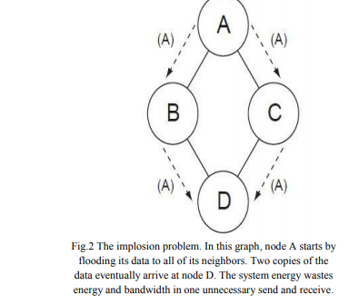
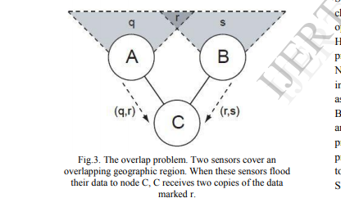

Slide 30
Sensor Protocols for Information via Negotiation (SPIN):
Sensor Protocols for Information via Negotiation was designed to improve classic flooding protocols. It fit under data delivery model in which the nodes sense data and disseminate the data throughout the network by means of negotiation. SPIN nodes use three types of messages for communication:
• ADV-When a node has new data to share; it can advertise this using ADV message containing Metadata.
• REQ-Node sends an REQ when it needs to receive actual data.
DATA- contains actual data

Slide 31
The SPIN family of protocols rests upon two basic ideas.
First, to operate efficiently and to conserve energy, sensor applications need to communicate with each other about the data that they already have and the data they still need to obtain. Exchanging sensor data may be an expensive network operation, but exchanging data about sensor data need not be.
Second, nodes in a network must monitor and adapt to changes in their own energy resources to extend the operating lifetime of the system.
Heinzelman proposed a family of adaptive protocols called Sensor Protocols for Information via Negotiation (SPIN) that disseminate all the information at each node to every node in the network assuming that all nodes in the network are potential BSs.
This enables a user to query any node and get the required information immediately. These protocols make use of the property that nodes in close proximity have similar data, and hence there is a need to only distribute the data other nodes do not posses.
SPIN is a negotiation-based information dissemination protocol suitable for WSN. It is based on the concept of metadata.

Slide 32
Meta-Data: Sensors use meta-data to succinctly and completely describe the data that they collect. If x is the meta-data descriptor for sensor data X then the size of x in bytes must be shorter than the size of X, for SPIN to be beneficial.
If two pieces of actual data are distinguishable, then their corresponding meta-data should be distinguishable.
Likewise, two pieces of indistinguishable data should share the same metadata representation.
SPIN does not specify a format for meta-data; this format is application-specific..

Slide 33
Spin Messages SPIN nodes use three types of messages for communication:
ADV-When a node has new data to share; it can advertise this using ADV message containing Metadata.
REQ-Node sends an REQ when it needs to receive actual data.
DATA- contains actual data . Because ADV and REQ messages contain only metadata, they are smaller, and cheaper to send and receive, than their corresponding DATA messages .

Slide 34
The SPIN family of protocols includes many protocols. The main two protocols are called SPIN-1 and SPIN-2, which incorporate negotiation before transmitting data in order to ensure that only useful information will be transferred.
Also, each node has its own resource manager which keeps track of resource consumption, and is polled by the nodes before data transmission.
The SPIN-1 protocol is a 3-stage protocol, as described above. An extension to SPIN-1 is SPIN-2, which incorporates threshold-based resource awareness mechanism in addition to negotiation. When energy in the nodes is abundant, SPIN-2 communicates using the 3-stage protocol of SPIN-1.
However, when the energy in a node starts approaching a low energy threshold, it reduces its participation in the protocol, i.e., it participates only when it believes that it can complete all the other stages of the protocol without going below the low-energy threshold. In conclusion, SPIN-l and SPIN-2 are simple protocols that efficiently disseminate data, while maintaining no per-neighbor state. These protocols are well-suited for an environment where the sensors are mobile because they base their forwarding decisions on local neighborhood information.

Slide 35
Other protocols of the SPIN family are–
SPIN-BC: This protocol is designed for broadcast channels.
SPIN-PP: This protocol is designed for a point to point communication, i.e., hop-by-hop routing.
SPIN-EC: This protocol works similar to SPIN-PP, but with an energy heuristic added to it
SPIN-RL: When a channel is lossy, a protocol called SPIN-RL is used where adjustments are added to the SPIN-PP protocol to account for the lossy channel.

Slide 36
One of the advantages of SPIN is that topological changes are localized since each node needs to know only its single-hop neighbors.
SPIN provides much energy savings than flooding and metadata negotiation almost halves the redundant data.
However, SPINs data advertisement mechanism cannot guarantee the delivery of data. To see this, consider the application of intrusion detection where data should be reliably reported over periodic intervals and assume that nodes interested in the data are located far away from the source node and the nodes between source and destination nodes are not interested in that data, such data will not be delivered to the destination at all.

Slide 37
Directed Diffusion
Directed diffusion is a popular data aggregation paradigm for WSNs.
Directed diffusion is a data-centric (DC) and application aware paradigm in the sense that all data generated by sensor nodes is named by attribute-value pairs.
The main idea of the DC paradigm is to combine the data coming from different sources enroute (in-network aggregation) by eliminating redundancy, minimizing the number of transmissions; thus saving network energy and prolonging its lifetime.
Unlike traditional end-to-end routing, DC routing finds routes from multiple sources to a single destination that allows in-network consolidation of redundant data.

Slide 38
In directed diffusion, sensors measure events and create gradients of information in their respective neighborhoods.
The base station requests data by broadcasting interests.
Interest describes a task required to be done by the network.
Interest diffuses through the network hop-by-hop, and is broadcast by each node to its neighbors.
As the interest is propagated throughout the network, gradients are setup to draw data satisfying the query towards the requesting node, i.e., a BS may query for data by disseminating interests and intermediate nodes propagate these interests.
Each sensor that receives the interest setup a gradient toward the sensor nodes from which it receives the interest.
This process continues until gradients are setup from the sources back to the BS.
More generally, a gradient specifies an attribute value and a direction.
The strength of the gradient may be different towards different neighbors resulting in different amounts of information flow.
At this stage, loops are not checked, but are removed at a later stage.

Slide 39
Figure below shows an example of the working of directed diffusion ((a) sending interests, (b) building gradients, and (c) data dissemination).
When interests fit gradients, paths of information flow are formed from multiple paths and then the best paths are reinforced so as to prevent further flooding according to a local rule.
In order to reduce communication costs, data is aggregated on the way.
The goal is to find a good aggregation tree which gets the data from source nodes to the BS.
The BS periodically refreshes and re-sends the interest when it starts to receive data from the source(s).
This is necessary because interests are not reliably transmitted throughout the network.

Slide 40
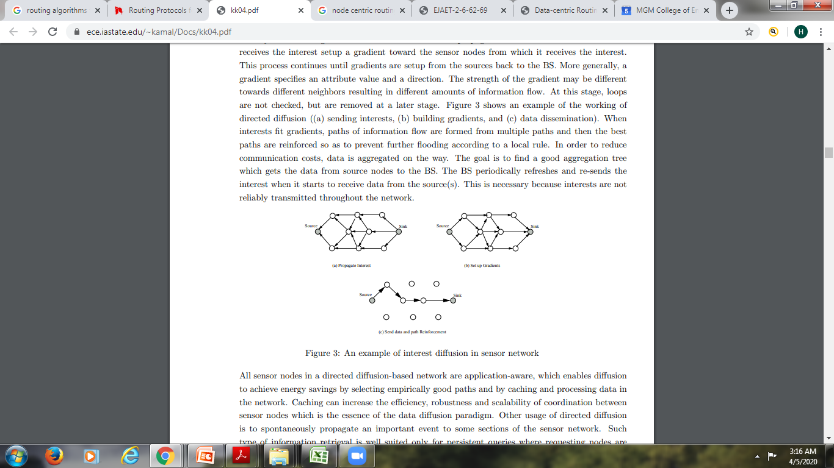

Slide 41
All sensor nodes in a directed diffusion-based network are application-aware, which enables diffusion to achieve energy savings by selecting empirically good paths and by caching and processing data in the network.
Caching can increase the efficiency, robustness and scalability of coordination between sensor nodes which is the essence of the data diffusion paradigm.
Other usage of directed diffusion is to spontaneously propagate an important event to some sections of the sensor network.
Such type of information retrieval is well suited only for persistent queries where requesting nodes are not expecting data that satisfy a query for duration of time.
This makes it unsuitable for one-time queries, as it is not worth setting up gradients for queries, which use the path only once.

Slide 42
Directed diffusion differs from SPIN in two aspects.
First, directed diffusion issues on demand data queries as the BS send queries to the sensor nodes by flooding some tasks.
In SPIN, however, sensors advertise the availability of data allowing interested nodes to query that data. Second, all communication in directed diffusion is neighbor-to-neighbor with each node having the capability of performing data aggregation and caching.
Unlike SPIN, there is no need to maintain global network topology in directed diffusion. However, directed diffusion may not be applied to applications (e.g., environmental monitoring) that require continuous data delivery to the BS. This is because the query driven on demand data model may not help in this regard.
Moreover, matching data to queries might require some extra overhead at the sensor nodes.

Slide 43
Rumor Routing
Rumor routing is a variation of directed diffusion and is mainly intended for applications where geographic routing is not feasible.
In general, directed diffusion uses flooding to inject the query to the entire network when there is no geographic criterion to diffuse tasks.
However, in some cases there is only a little amount of data requested from the nodes and thus the use of flooding is unnecessary.
An alternative approach is to flood the events if the number of events is small and the number of queries is large.
The key idea is to route the queries to the nodes that have observed a particular event rather than flooding the entire network to retrieve information about the occurring events.
In order to flood events through the network, the rumor routing algorithm employs long-lived packets, called agents.
When a node detects an event, it adds such event to its local table, called events table, and generates an agent.
Agents travel the network in order to propagate information about local events to distant nodes.
When a node generates a query for an event, the nodes that know the route, may respond to the query by inspecting its event table. Hence, there is no need to flood the whole network, which reduces the communication cost.
On the other hand, rumor routing maintains only one path between source and destination as opposed to directed diffusion where data can be routed through multiple paths at low rates.

Slide 44
Rumor routing can achieve significant energy savings when compared to event flooding and can also handle node’s failure.
However, rumor routing performs well only when the number of events is small.
For a large number of events, the cost of maintaining agents and event-tables in each node becomes infeasible if there is not enough interest in these events from the BS.

Slide 45
Minimum Cost Forwarding Algorithm (MCFA):
Minimum Cost Forwarding Algorithm (MCFA) computes the least cost from each node to the Base Station (BS).
Each node maintains the least cost estimate from itself to the base-station.
Each message to be forwarded by the sensor node is broadcast to its neighbors.
When a node receives the message, it checks if it is on the least cost path between the source sensor node and the base-station.
If the node is in the shortest path, the node retransmits the data; the same procedure repeats until the packet reaches the BS.
Nevertheless, computing and updating the Minimum Cost generates overhead.

Slide 46
This protocol consists of two modes
Initialization Mode
Operational Mode

Slide 47
Initialization Mode
To begin establishing a minimum cost field the base station generates a single advertisement message with a cost of zero.
A general node, i, sets its minimum cost, Li, to infinity and waits for ADV messages to arrive each containing a cost field, Lm.
Each node, upon receiving the broadcast message originated at the base-station, checks to see If the value of the cost field plus the link cost is less than the current minimum cost, the node updates its minimum cost.
If the received broadcast message is updated, then it is re-sent; otherwise, it is purged and nothing further is done.
However, this procedure may result in some nodes having multiple updates and those nodes far away from the base-station will get more updates from those closer to the base-station.
To avoid this, the MCFA was modified to run a back off algorithm at the setup phase.
The back off algorithm dictates that a node will not send the updated message until some time units have elapsed from the time at which the message is updated
When the timer finally expires, the node broadcasts its ADV message advertising its minimum cost.
The back off time is thus proportional to the minimum cost at a node. Thus, a node will defer its ADV broadcast until it has heard the message leading to the minimum cost and make a single broadcast carrying its minimum cost.

Slide 48
Operational Mode
Once the cost field has been established, nodes engage in the OPER mode protocol. The base station simply consumes DATA messages forwarded by nodes.
DATA messages contain the data collected at a sensor node, the original cost and the consumed cost.

Slide 49
Gradient-Based Routing:
The general structure of a WSN consists of a large number of sensor nodes whose purpose is to gather information about physical objects of a network area.
Traditionally, the gathered information is then routed to a single base station (sink) for processing and analysis purposes.
As a general wireless communication principle, sensor nodes have a maximum transmission range.
Therefore, to route data to the sink node, a multihop transmission strategy is adopted.
In general, the energy consumption of sensor nodes next to the sink is higher compared to the one of other sensor nodes in the network.
This is due to the fact that the network traffic is unevenly distributed.
Considering their position next to the sink node, most of the network traffic passes through the sink’s neighbour nodes.
This effect considerably reduces the network lifetime as the energy of the sensor nodes next to the sink rapidly depletes resulting in no possibility to reach the sink.
This effect is referred to as the ‘bottleneck’ problem . The ‘bottleneck’ problem is accentuated in large-scale networks because of the many-to-one network traffic pattern which increases the energy unbalance in WSNs with a single sink node.

Slide 50
The use of a multiple sinks network topology can provide multiple alternative routes from a source node to one of the interconnected sink nodes.
This can shorten transmission distances and therefore reduce the network energy cost. Since sensor nodes play the dual role of both event detectors and data routers, the larger the number of hops involved in the routing of data packets to the sink, the greater are the overheads experienced, leading to higher energy cost.

Slide 51
Schurgers proposed another variant of directed diffusion, called Gradient-Based Routing (GBR).
The key idea in GBR is to memorize the number of hops when the interest is diffused through the whole network.
As such, each node can calculate a parameter called the height of the node, which is the minimum number of hops to reach the BS.
The difference between a node’s height and that of its neighbor is considered the gradient on that link.

Slide 52
A packet is forwarded on a link with the largest gradient.
GBR uses some auxiliary techniques such as data aggregation and traffic spreading in order to uniformly divide the traffic over the network.

Slide 53
In GBR, three different data dissemination techniques have been discussed (1) Stochastic Scheme, where a node picks one gradient at random when there are two or more next hops that have the same gradient,
(2) Energy-based scheme, where a node increases its height when its energy drops below a certain threshold, so that other sensors are discouraged from sending data to that node, and
(3) Stream-based scheme, where new streams are not routed through nodes that are currently part of the path of other streams.
The main objective of these schemes is to obtain a balanced distribution of the traffic in the network, thus increasing the network lifetime.
Simulation results of GBR showed that GBR outperforms directed diffusion in terms of total communication energy

Slide 54
Energy Aware Routing:
The objective of energy-aware routing protocol , a destination initiated reactive protocol, is to increase the network lifetime.
Although this protocol is similar to directed diffusion, it differs in the sense that it maintains a set of paths instead of maintaining or enforcing one optimal path at higher rates.
These paths are maintained and chosen by means of a certain probability.
The value of this probability depends on how low the energy consumption of each path can be achieved.
By having paths chosen at different times, the energy of any single path will not deplete quickly.
This can achieve longer network lifetime as energy is dissipated more equally among all nodes.
Network survivability is the main metric of this protocol.

Slide 55
The protocol assumes that each node is addressable through a class-based addressing which includes the location and types of the nodes.
The protocol initiates a connection through localized flooding, which is used to discover all routes between source/destination pair and their costs; thus building up the routing tables.
The high-cost paths are discarded and a forwarding table is built by choosing neighboring nodes in a manner that is proportional to their cost.
Then, forwarding tables are used to send data to the destination with a probability that is inversely proportional to the node cost.
When compared to directed diffusion, this protocol provides an overall improvement of 21.5% energy saving and a 44% increase in network lifetime.
However, the approach requires gathering the location information and setting up the addressing mechanism for the nodes, which complicate route setup compared to the directed diffusion.

Slide 56
Hierarchical routing
Hierarchical or cluster-based routing, originally proposed in wireline networks, are well-known techniques with special advantages related to scalability and efficient communication.
As such, the concept of hierarchical routing is also utilized to perform energy-efficient routing in WSNs.
In a hierarchical architecture, higher energy nodes can be used to process and send the information while low energy nodes can be used to perform the sensing in the proximity of the target.
This means that creation of clusters and assigning special tasks to cluster heads can greatly contribute to overall system scalability, lifetime, and energy efficiency.
Hierarchical routing is an efficient way to lower energy consumption within a cluster and by performing data aggregation and fusion in order to decrease the number of transmitted messages to the BS.
Hierarchical routing is mainly two-layer routing where one layer is used to select cluster heads and the other layer is used for routing.
However, most techniques in this category are not about routing, rather on ”who and when to send or process/aggregate” the information, channel allocation etc., which can be orthogonal to the multihop routing function.

Slide 57
LEACH protocol
Already discussed

Slide 58
Power-Efficient Gathering in Sensor Information Systems (PEGASIS)
This protocol is an enhancement over LEACH protocol .
The protocol, called Power-Efficient Gathering in Sensor Information Systems (PEGASIS), is a near optimal chain-based protocol.
The basic idea of the protocol is that in order to extend network lifetime, nodes need only communicate with their closest neighbors and they take turns in communicating with the base-station.
When the round of all nodes communicating with the base-station ends, a new round will start and so on.
This reduces the power required to transmit data per round as the power draining is spread uniformly over all nodes.
Hence, PEGASIS has two main objectives. First, increase the lifetime of each node by using collaborative techniques and as a result the network lifetime will be increased.
Second, allow only local coordination between nodes that are close together so that the bandwidth consumed in communication is reduced.
Unlike LEACH, PEGASIS avoids cluster formation and uses only one node in a chain to transmit to the BS instead of using multiple nodes

Slide 59
To locate the closest neighbor node in PEGASIS, each node uses the signal strength to measure the distance to all neighboring nodes and then adjust the signal strength so that only one node can be heard.
The chain in PEGASIS will consist of those nodes that are closest to each other and form a path to the base-station.
The aggregated form of the data will be sent to the base-station by any node in the chain and the nodes in the chain will take turns in sending to the base-station.
Simulation results showed that PEGASIS is able to increase the lifetime of the network twice as much the lifetime of the network under the LEACH protocol.
Such performance gain is achieved through the elimination of the overhead caused by dynamic cluster formation in LEACH and through decreasing the number of transmissions and reception by using data aggregation.
Although the clustering overhead is avoided, PEGASIS still requires dynamic topology adjustment since a sensor node needs to know about energy status of its neighbors in order to know where to route its data.

Slide 60
Such topology adjustment can introduce significant overhead especially for highly utilized networks.
Moreover, PEGASIS assumes that each sensor node can be able to communicate with the BS directly.
In practical cases, sensor nodes use multihop communication to reach the base-station.
Also, PEGASIS assumes that all nodes maintain a complete database about the location of all other nodes in the network.
In addition, PEGASIS assumes that all sensor node have the same level of energy and they are likely to die at the same time. Note also that PEGASIS introduces excessive delay for distant node on the chain.

Slide 61
An extension to PEGASIS, called Hierarchical-PEGASIS was introduced in with the objective of decreasing the delay incurred for packets during transmission to the BS.
For this purpose, simultaneous transmissions of data are studied in order to avoid collisions through approaches that incorporates signal coding and spatial transmissions.
In the later, only spatially separated nodes are allowed to transmit at the same time.
The chain-based protocol with CDMA capable nodes, constructs a chain of nodes, that forms a tree like hierarchy, and each selected node in a particular level transmits data to the node in the upper level of the hierarchy.
This method ensures data transmitting in parallel and reduces the delay significantly. Such hierarchical extension has been shown to perform better than the regular PEGASIS scheme by a factor of about 60.

Slide 62
Threshold-sensitive Energy Efficient Protocols (TEEN and APTEEN):
Two hierarchical routing protocols called TEEN (Threshold-sensitive Energy Efficient sensor Network protocol), and APTEEN (Adaptive Periodic Threshold-sensitive Energy Efficient sensor Network protocol) are proposed by researchers .
These protocols were proposed for time-critical applications.
In TEEN, sensor nodes sense the medium continuously, but the data transmission is done less frequently.
A cluster head sensor sends its members a hard threshold, which is the threshold value of the sensed attribute and a soft threshold, which is a small change in the value of the sensed attribute that triggers the node to switch on its transmitter and transmit.
Thus the hard threshold tries to reduce the number of transmissions by allowing the nodes to transmit only when the sensed attribute is in the range of interest.
The soft threshold further reduces the number of transmissions that might have otherwise occurred when there is little or no change in the sensed attribute.
A smaller value of the soft threshold gives a more accurate picture of the network, at the expense of increased energy consumption.
Thus, the user can control the trade-off between energy efficiency and data accuracy. When cluster-heads are to change , new values for the above parameters are broadcast. The main drawback of this scheme is that, if the thresholds are not received, the nodes will never communicate, and the user will not get any data from the network at all.

Slide 63
The nodes sense their environment continuously. The first time a parameter from the attribute set reaches its hard threshold value, the node switches its transmitter on and sends the sensed data. The sensed value is stored in an internal variable, called Sensed Value (SV). The nodes will transmit data in the current cluster period only when the following conditions are true: (1) The current value of the sensed attribute is greater than the hard threshold (2) The current value of the sensed attribute differs from SV by an amount equal to or greater than the soft threshold.

Slide 64
Important features of TEEN include its suitability for time critical sensing applications. Also, since message transmission consumes more energy than data sensing, so the energy consumption in this scheme is less than the proactive networks. The soft threshold can be varied. At every cluster change time, a fresh parameters are broadcast and so, the user can change them as required.
APTEEN, on the other hand, is a hybrid protocol that changes the periodicity or threshold values used in the TEEN protocol according to the user needs and the type of the application.

Slide 65
In APTEEN, the cluster-heads broadcasts the following parameters : 1. Attributes (A): this is a set of physical parameters which the user is interested in obtaining information about. 2. Thresholds: this parameter consists of the Hard Threshold (HT) and the Soft Threshold (ST). 3. Schedule: this is a TDMA schedule, assigning a slot to each node. 4. Count Time (CT): it is the maximum time period between two successive reports sent by a node.

Slide 66
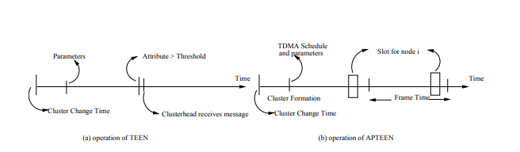

Slide 67
The node senses the environment continuously, and only those nodes which sense a data value at or beyond the hard threshold transmit.
Once a node senses a value beyond HT, it transmits data only when the value of that attribute changes by an amount equal to or greater than the ST.
If a node does not send data for a time period equal to the count time, it is forced to sense and retransmit the data.
A TDMA schedule is used and each node in the cluster is assigned a transmission slot.
Hence, APTEEN uses a modified TDMA schedule to implement the hybrid network.
The main features of the APTEEN scheme include the following. It combines both proactive and reactive policies.
It offers a lot of flexibility by allowing the user to set the count-time interval (CT), and the threshold values for the energy consumption can be controlled by changing the count time as well as the threshold values.
The main drawback of the scheme is the additional complexity required to implement the threshold functions and the count time.
Simulation of TEEN and APTEEN has shown that these two protocols outperform LEACH.
The experiments have demonstrated that APTEENs performance is somewhere between LEACH and TEEN in terms of energy dissipation and network lifetime.
TEEN gives the best performance since it decreases the number of transmissions.
The main drawbacks of the two approaches are the overhead and complexity associated with forming clusters at multiple levels, the method of implementing threshold-based functions, and how to deal with attribute-based naming of queries.

Slide 68
Location based routing protocols
In this kind of routing, sensor nodes are addressed by means of their locations.
The distance between neighboring nodes can be estimated on the basis of incoming signal strengths.
Relative coordinates of neighboring nodes can be obtained by exchanging such information between neighbors .
Alternatively, the location of nodes may be available directly by communicating with a satellite, using GPS (Global Positioning System), if nodes are equipped with a small low power GPS receiver .
To save energy, some location based schemes demand that nodes should go to sleep if there is no activity. More energy savings can be obtained by having as many sleeping nodes in the network as possible.

Slide 69
Geographic Adaptive Fidelity (GAF)
GAF is an energy-aware location-based routing algorithm designed primarily for mobile ad hoc networks, but may be applicable to sensor networks as well.
The network area is first divided into fixed zones and form a virtual grid.
Inside each zone, nodes collaborate with each other to play different roles.
For example, nodes will elect one sensor node to stay awake for a certain period of time and then they go to sleep.
This node is responsible for monitoring and reporting data to the BS on behalf of the nodes in the zone.
Hence, GAF conserves energy by turning off unnecessary nodes in the network without affecting the level of routing fidelity.
Each node uses its GPS-indicated location to associate itself with a point in the virtual grid.
Nodes associated with the same point on the grid are considered equivalent in terms of the cost of packet routing. Such equivalence is exploited in keeping some nodes located in a particular grid area in sleeping state in order to save energy.
Thus, GAF can substantially increase the network lifetime as the number of nodes increases.

Slide 70
There are three states defined in GAF.
These states are
discovery, for determining the neighbors in the grid
active reflecting participation in routing
sleep when the radio is turned off.
In order to handle the mobility, each node in the grid estimates its leaving time of grid and sends this to its neighbors.
The sleeping neighbors adjust their sleeping time accordingly in order to keep the routing fidelity.
Before the leaving time of the active node expires, sleeping nodes wake up and one of them becomes active.
GAF is implemented both for non-mobility (GAFbasic) and mobility (GAF-mobility adaptation) of nodes

Slide 71
Geographic and Energy Aware Routing (GEAR):
The protocol, called Geographic and Energy Aware Routing (GEAR), uses energy aware and geographically-informed neighbor selection heuristics to route a packet towards the destination region.
The key idea is to restrict the number of interests in directed diffusion by only considering a certain region rather than sending the interests to the whole network.
By doing this, GEAR can conserve more energy than directed diffusion.

Slide 72
Each node in GEAR keeps an estimated cost and a learning cost of reaching the destination through its neighbors.
The estimated cost is a combination of residual energy and distance to destination.
The learned cost is a refinement of the estimated cost that accounts for routing around holes in the network.
A hole occurs when a node does not have any closer neighbor to the target region than itself.
If there are no holes, the estimated cost is equal to the learned cost.
The learned cost is propagated one hop back every time a packet reaches the destination so that route setup for next packet will be adjusted

Slide 73
There are two phases in the algorithm:
(1) Forwarding packets towards the target region: Upon receiving a packet, a node checks its neighbors to see if there is one neighbor, which is closer to the target region than itself.
If there is more than one, the nearest neighbor to the target region is selected as the next hop.
If they are all further than the node itself, this means there is a hole. In this case, one of the neighbors is picked to forward the packet based on the learning cost function.
This choice can then be updated according to the convergence of the learned cost during the delivery of packets, and
(2) Forwarding the packets within the region: If the packet has reached the region, it can be diffused in that region by either recursive geographic forwarding or restricted flooding. Restricted flooding is good when the sensors are not densely deployed.
In high-density networks, recursive geographic flooding is more energy efficient than restricted flooding.
In that case, the region is divided into four sub regions and four copies of the packet are created. This splitting and forwarding process continues until the regions with only one node are left.

Slide 74
Routing Protocols based on Protocol Operation
It should be noted that some of these protocols may fall below one or more of the above routing categories.

Slide 75
Multipath routing protocols
The fault tolerance (resilience) of a protocol is measured by the likelihood that an alternate path exists between a source and a destination when the primary path fails.
This can be increased by maintaining multiple paths between the source and the destination at the expense of an increased energy consumption and traffic generation.
These alternate paths are kept alive by sending periodic messages.
Hence, network reliability can be increased at the expense of increased overhead of maintaining the alternate paths.

Slide 76
In this algorithm data will be routed through a path whose nodes have the largest residual energy.
The path is changed whenever a better path is discovered.
The primary path will be used until its energy falls below the energy of the backup path at which the backup path is used.
Using this approach, the nodes in the primary path will not deplete their energy resources through continual use of the same route, hence achieving longer life.
However, the path switching cost was not quantified in the paper.

Slide 77
Directed diffusion is a good candidate for robust multipath routing and delivery.
It has been found that the use of multipath routing provides viable alternative for energy efficient recovery from failures in WSN.
The motivation of using these braided paths is to keep the cost of maintaining the multipaths low.
The costs of alternate paths are comparable to the primary path because they tend to be much closer to the primary path.

Slide 78
Query based routing
In this kind of routing, the destination nodes propagate a query for data (sensing task) from a node through the network and a node having this data sends the data which matches the query back to the node, which initiates the query.
Usually these queries are described in natural language, or in high-level query languages.
For example, client C1 may submit a query to node N1 and ask: Are there moving vehicles in battle space region 1?
. All the nodes have tables consisting of the sensing tasks queries that they receive and send data which matches these tasks when they receive it.
Directed diffusion is an example of this type of routing.
In directed diffusion, the BS node sends out interest messages to sensors.
As the interest is propagated throughout the sensor network, the gradients from the source back to the BS are set up.
When the source has data for the interest, the source sends the data along the interests gradient path.
To lower energy consumption, data aggregation (e.g., duplicate suppression) is performed enroute.

Slide 79
Negotiation based routing protocols
These protocols use high level data descriptors in order to eliminate redundant data transmissions through negotiation.
Communication decisions are also taken based on the resources that are available to them.
The SPIN family protocols are examples of negotiation based routing protocols.
The motivation is that the use of flooding to disseminate data will produce implosion and overlap between the sent data, hence nodes will receive duplicate copies of the same data.
This operation consumes more energy and more processing by sending the same data by different sensors.
The SPIN protocols are designed to disseminate the data of one sensor to all other sensors assuming these sensors are potential base-stations.
Hence, the main idea of negotiation based routing in WSNs is to suppress duplicate information and prevent redundant data from being sent to the next sensor or the base-station by conducting a series of negotiation messages before the real data transmission begins.

Slide 80
QoS-based routing
In QoS-based routing protocols, the network has to balance between energy consumption and data quality. In particular, the network has to satisfy certain QoS metrics, e.g., delay, energy, bandwidth, etc. when delivering data to the BS.

Slide 81
Sequential Assignment Routing
Sequential Assignment Routing (SAR) is one of the first routing protocols for WSNs that introduces the notion of QoS in the routing decisions.
Routing decision in SAR is dependent on three factors:
energy resources, QoS on each path, and the priority level of each packet.
To avoid single route failure, a multi-path approach is used and localized path restoration schemes are used.
To create multiple paths from a source node, a tree rooted at the source node to the destination nodes (i.e., the set of base-stations (BSs)) is built.
The paths of the tree are built while avoiding nodes with low energy or QoS guarantees.
At the end of this process, each sensor node will be part of multi-path tree.
As such, SAR is table-driven multi-path protocol that aims to achieve energy efficiency and fault tolerance.
In essence, SAR calculates a weighted QoS metric as the product of the additive QoS metric and a weight coefficient associated with the priority level of the packet

Slide 82
Coherent and non-coherent processing
Data processing is a major component in the operation of wireless sensor networks.
Hence, routing techniques employ different data processing techniques.
In general, sensor nodes will cooperate with each other in processing different data flooded in the network area.
Two examples of data processing techniques proposed in WSNs are coherent and non-coherent data processing-based routing .
In non-coherent data processing routing, nodes will locally process the raw data before being sent to other nodes for further processing.
The nodes that perform further processing are called the aggregators.
In coherent routing, the data is forwarded to aggregators after minimum processing.
The minimum processing typically includes tasks like time stamping, duplicate suppression, etc.
To perform energy-efficient routing, coherent processing is normally selected.

Slide 83
Non-coherent functions have fairly low data traffic loading.
On the other hand, since coherent processing generates long data streams, energy efficiency must be achieved by path optimality.
In non-coherent processing, data processing incurs three phases: (1) Target detection, data collection, and preprocessing (2) Membership declaration, and (3) Central node election.
During phase 1, a target is detected, its data collected and preprocessed.
When a node decides to participate in a cooperative function, it will enter phase 2 and declare this intention to all neighbors.
This should be done as soon as possible so that each sensor has a local understanding of the network topology.
Phase 3 is the election of the central node.
Since the central node is selected to perform more sophisticated information processing, it must have sufficient energy reserves and computational capability.

